Slide 1
B.TECH IN CSE
“Addressing Data Scalability Challenges in Social Media Platforms”
RAI TECHNOLOGY UNIVERSITY
BANGALURU
Presented By: Submitted To:
DEEPAK V P Mr. Abhishek S
RTU24101CS053 Project Guide

Slide 2
CONTENT
Introduction
Problem Statement
Literature Survey
Proposed Solution and Methodology
Solution Development
Scalability& Performance analysis
Conclusion

Slide 3
INTRODUCTION
In the digital era, social media generates vast user data, posing scalability challenges in storage, processing, and retrieval. Real-time analytics, personalized recommendations, and content moderation add to these demands. Emerging technologies like distributed computing, machine learning, and parallel processing offer solutions. This work explores cost-effective methods, including scalable databases, cloud storage, and ML-based analytics, to enhance social media data management while ensuring scalability, accuracy, and reliability.

Slide 4
PROBLEM STATEMENT
Social media platforms generate massive content, including posts, images, and videos. Managing this data efficiently is crucial for storage, retrieval, and system performance. Traditional methods struggle with the growing volume and speed, leading to slow responses, high costs, data duplication, and inefficiencies in moderation and analytics.

Slide 5
LITERATURE SURVEY
Kottala et al. (2024) analyze the accuracy vs. scalability trade-off in machine learning models, demonstrating that high-accuracy models require extensive computational resources, making them less practical for real-time analytics
Huang and Wang (2017) emphasize the importance of parallel processing and distributed computing architectures in managing the high volume of social media interactions

Slide 6
PROPOSED SOLOUTION AND METHODOLOGY
Scalable Data Lifecycle Management System (SDLMS)
Efficient storage, retrieval & processing of large-scale social media data.
AI-driven indexing, caching & intelligent data management.
Real-time analytics with cost-effective storage solutions
Scalable, high-performance architecture for millions of users.

Slide 7
SOLUTION DEVELOPMENT
Managing data in multi-cloud environments is complex due to diverse sources and platforms. A centralized integration framework using cloud-native services, real-time ingestion, ETL/ELT pipelines, and AI-driven processing ensures scalability, security, and efficiency for seamless data collection, transformation, storage, and analytics.

Slide 8
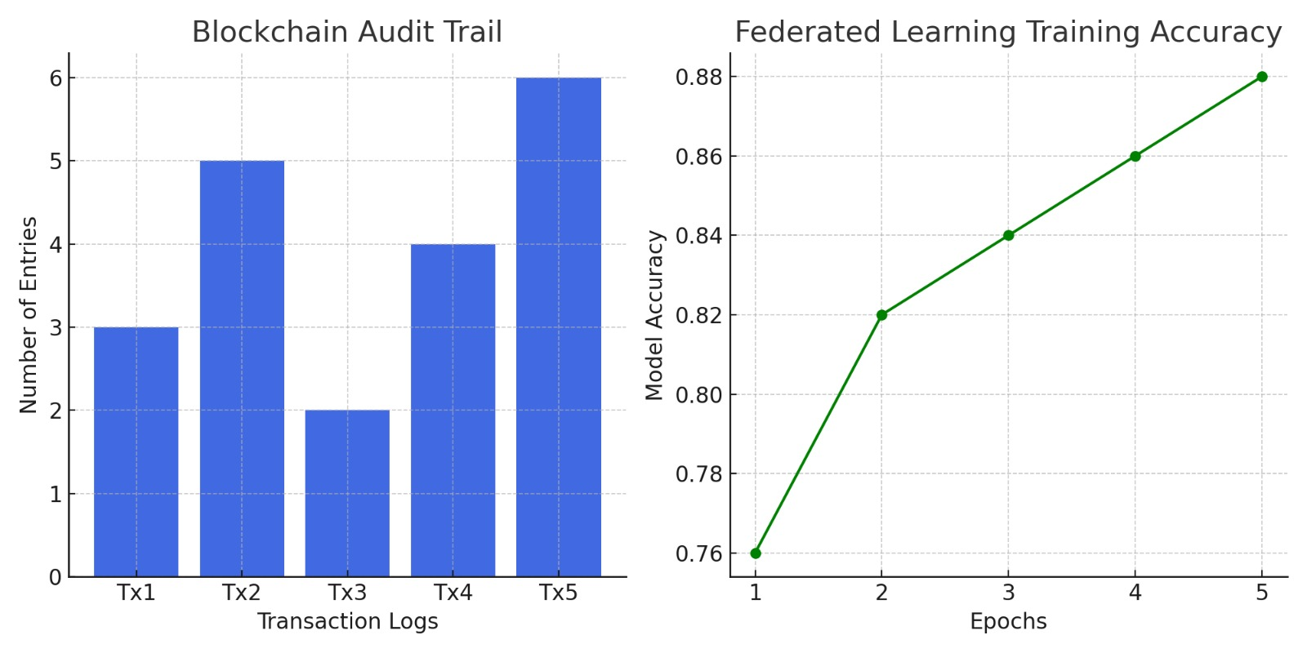
Federated Learning Training Accuracy – A line graph showing model accuracy over epochs.

Slide 9
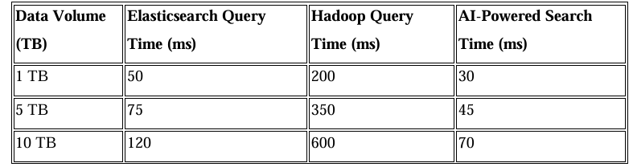
SCALABILITY & PERFORMANCE ANALYSIS
Query Performance Under Increasing Data Load

Slide 10
CONCLUSION
The Scalable Data Lifecycle Management System (SDLMS) tackles social media scalability with distributed computing, AI, and real-time processing. It improves data retrieval, storage, and decision-making while reducing query latency and costs. Challenges include GPU costs and ethical AI. Future research focus on privacy, misinformation detection, and edge AI for better scalability and security

Slide 11
Thank you all

